Slide 1
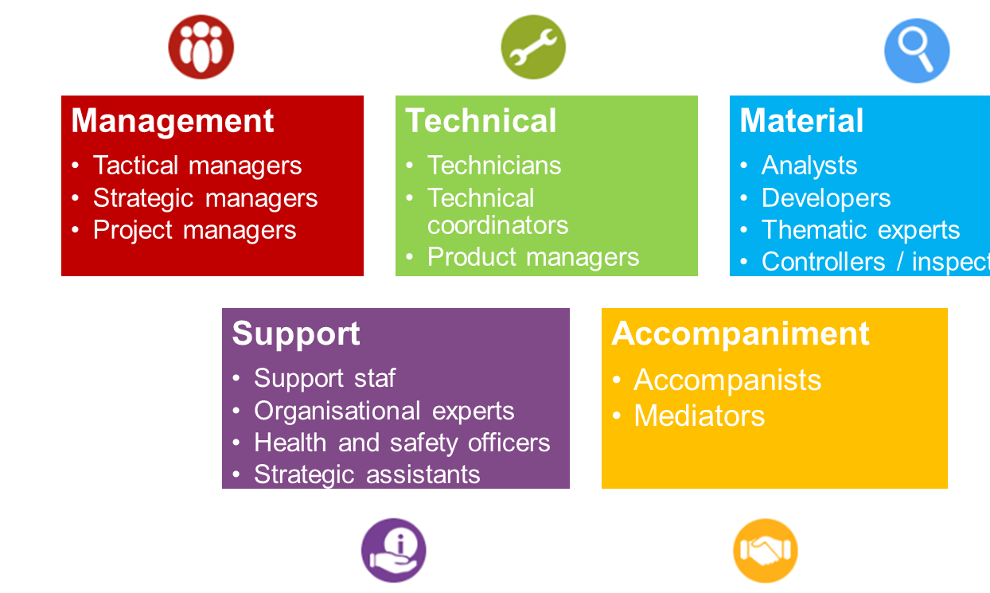
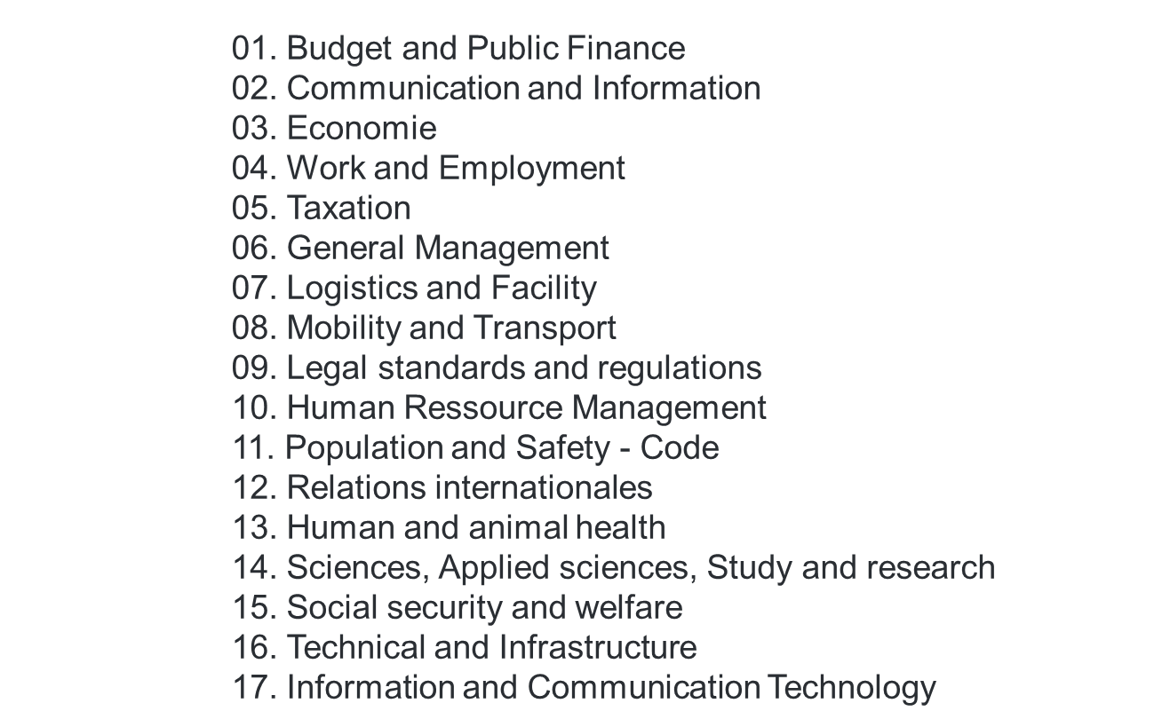
Two axes of job architecture
Job families
Business categories
Notes:
Jobs are clustered into job families by grouping roles with similar work process
For each job family: common competency profiles
Job families are much broader than job descriptions and more generic
Job families are an intermediate level of aggregation (grouping of jobs with one or more similar work processes. They constitute the basis of workforce planning and HR processes
Jobs are clustered by core business (business categories)
Cluster consists of grouping jobs by specific areas of expertise or knowledge
For each category, technical competency profiles are tailored to the different job families and job levels within its scope

Slide 2
Job architecture of the classification in the Belgian federal civil service
A unique, stable and cross-cutting competency model
Job families as a basic job catalogue
Job descriptions as living objects but framed
Classification of positions as a separate, governed and standardised mechanism
Architecture strictly aligned with:
Competency-based public administration International Job Architecture Practices
Competency model
Job classification
Job families
Job descriptions
Business categories

